Slide 1
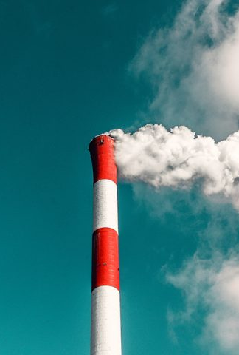
Final Project- Based on Global Air Pollution dataset
Submitted to:Prof. Tom Breur
Submitted by: Vartika Joshi
NUID: 002760320

Slide 2

INTRODUCTION
Data on the Air Quality Index (AQI) scores for various cities around the world are included in the dataset.
Columns identifying the nation and city where the data was gathered, AQI levels, and classifications for various contaminants are all included (CO, ozone, NO2, PM2.5).
The air quality in various cities throughout the world is analyzed and compared using this data.
The dataset is used to examine the air quality in different regions of the world and to compare the AQI values for different pollutants (such as CO, ozone, NO2, and PM2.5) across various cities and countries.

Slide 3

EXPLORATORY DATA ANALYSIS
There are 12 columns and 23463 rows. The dataset provides details about country, cities, air quality values and air quality category.
90% of the time, the AQI for ozone levels in cities falls into the good category and the city's nitrogen dioxide AQI rating is 100% Good Category.
The highest value of kurtosis is observed in CO, demonstrating the extremely unequal distribution of CO.

Slide 4

QUESTIONS EXPLORED
Question 1. Does the air quality values vary across different countries, cities, or AQI categories?
Question 2. Are there any significant differences in the air quality values for different types of air pollutants (e.g., CO, Ozone, NO2, PM2.5)?
Question 3. Is there a relationship between the air quality values and the observation's country, city, or AQI category?
Question 4. Are there any notable trends in the data that could be of interest or concern?

Slide 5
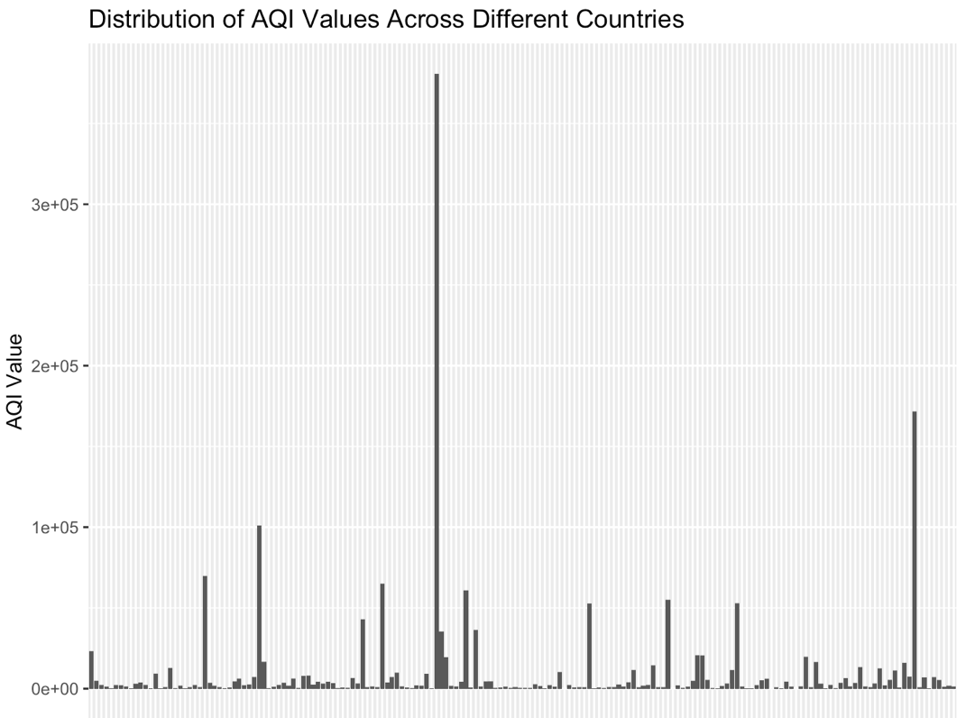
FINDINGS
1. The value of air quality varies between countries and cities. While some towns and nations have AQI values as high as 500, which the AQI category deems "Hazardous," others have AQI values as low as 20, which the AQI category deems "Good.”

Slide 6
FINDINGS contd…
2. The lower AQI value cities and countries typically have lower levels of air pollutants like ozone, a dangerous chemical.
3. Because of their geographic position, temperature, or industrial activity, certain cities or countries have higher air quality values.
4. With AQI values of 500, the majority of the cities and nations in the data set have consistently bad air quality. A potential public health problem is also indicated by the fact that several of the observations fall into the "Hazardous" or "Unhealthy" AQI categories.

Slide 7
NULL AND ALTERNATE HYPOTHESIS
The null hypothesis states that the average AQI value for cities in the United States is not significantly different from the average AQI value for cities in all countries in the dataset, while the alternative hypothesis states that the average AQI value for cities in the United States is significantly different from the average AQI value for cities in all countries.

Slide 8
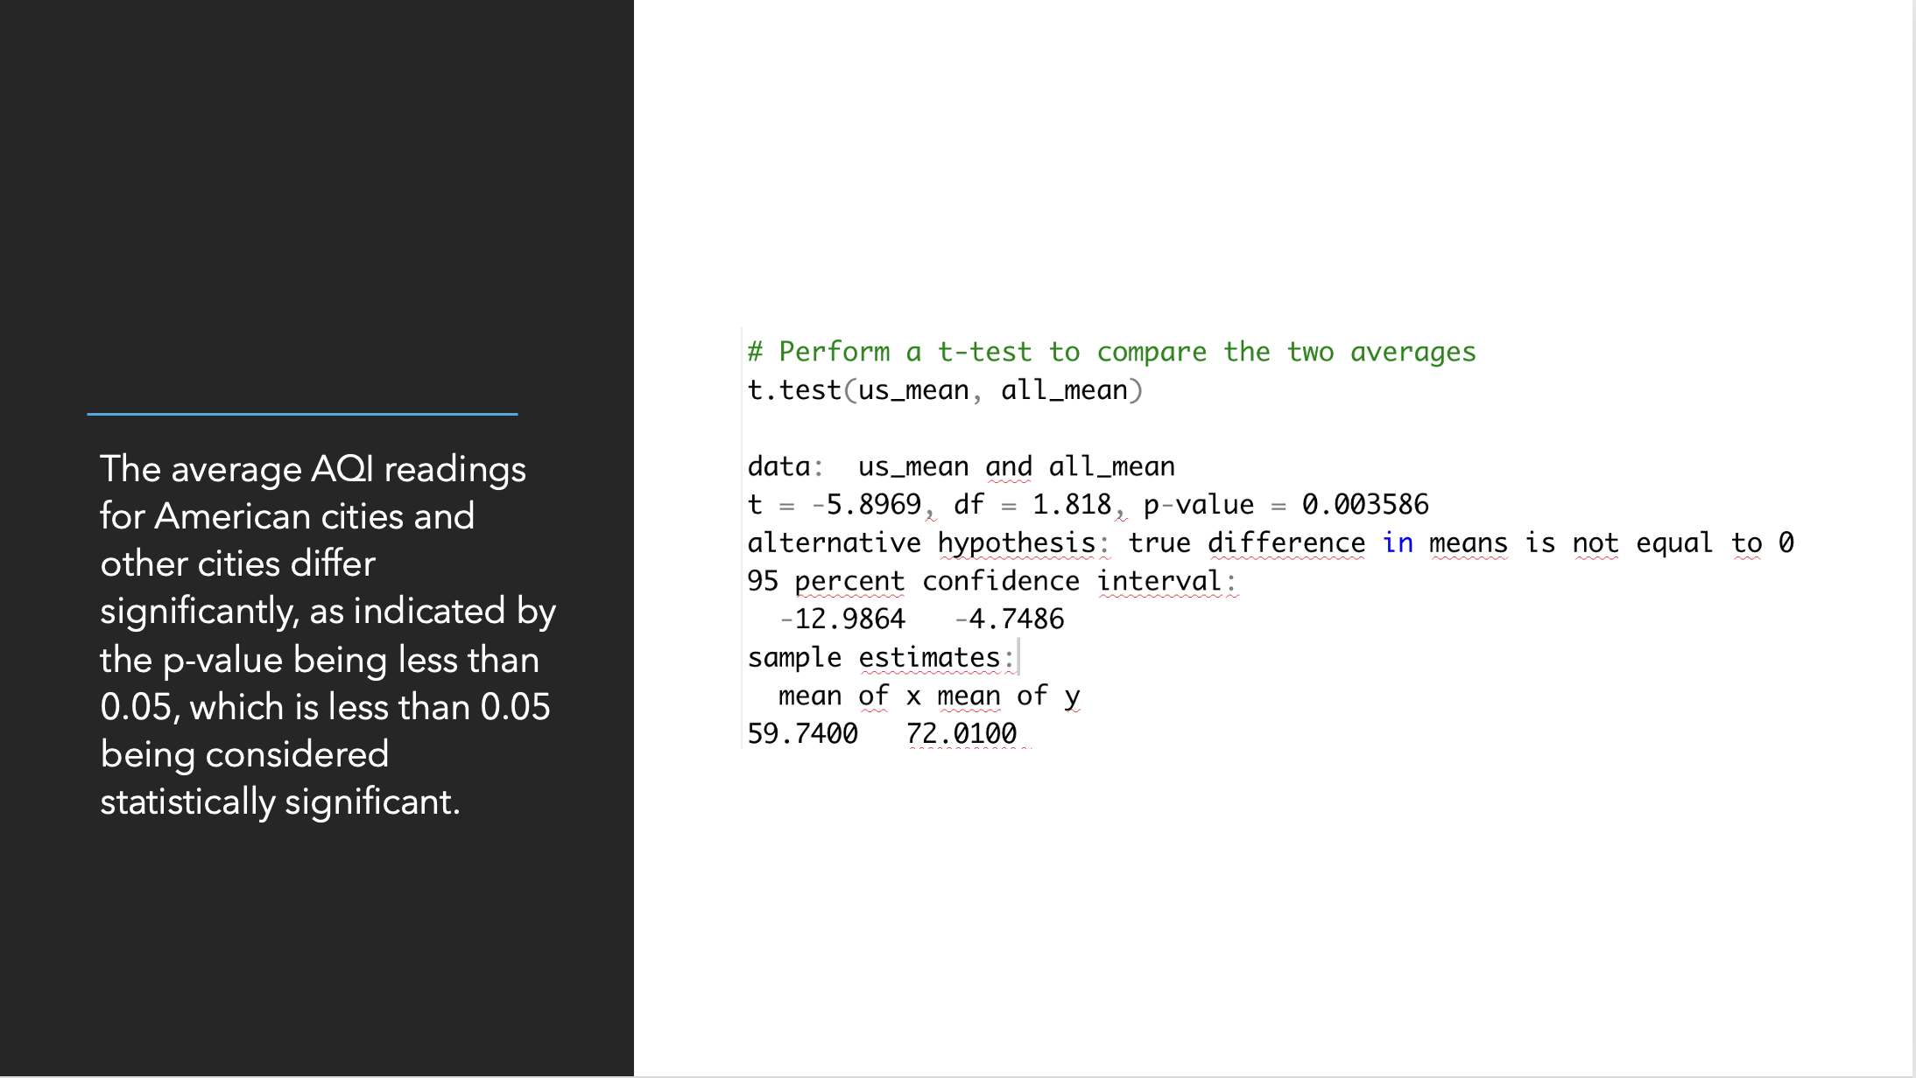

Slide 9

RESULT
AQI Value is the dependent variable, and the independent variables are CO AQI Value, Ozone AQI Value, NO2 AQI Value, and PM 2.5 Value.
The null hypothesis states that there is no association between AQI Value and CO AQI Value, whereas the alternative hypothesis states that there is a substantial relationship between these two variables.
The result indicate that there is strong connection between AQI Value and pollutant AQI Value.

Slide 10
REFRENCES
[1] World Health Organization. (n.d.). World Health Organization (WHO). World Health Organization. Retrieved December 13, 2022, from https://www.who.int/health-topics/air-pollution#tab=tab_1
[2] What is R? R. (n.d.). Retrieved December 13, 2022, from https://www.r-project.org/about.html
[3] Bluman, A. G. (2018). Elementary statistics: A step by step approach. McGraw-Hill Education.

Slide 11

THANK YOU

